Slide 1
Eli Chandler Sprint 007
August 8th – August 27th (Final Sprint)
Work hard rating 5/5

Slide 2
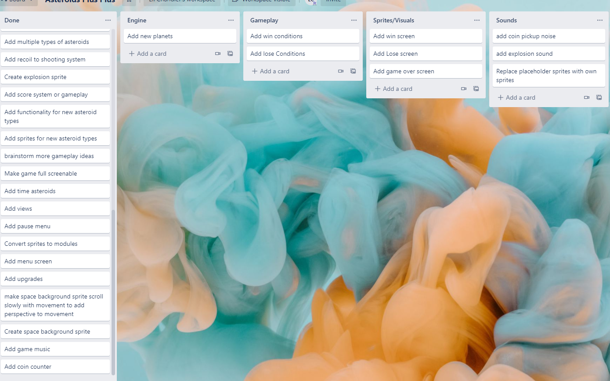
KANBAN Board at the start of the sprint

Slide 3
Sprint reflection and summary
During this sprint I finalized the game into a final playable game, that has a goal and a way to lose. I also added new sprites and sound effects to replace my old ones, so that the game had a more continuous art style, and the sounds gave the game significantly more life overall.
The game is now fully playable, and I have tested all conditions to make sure there are no glitches in the game that affect the gameplay. I also used this sprint to get users to test the game to give feedback on gameplay and if they knew what to do or not (talked about further in the testing slide)

Slide 4
Major changes and achievements
Added tutorial so people know what to do
Added new sprites I made myself to give the game a consistent art style and feel
Adjusted gameplay mechanics based on user feedback (More on this in next slide)
Added sound effects to most actions in the game to give satisfying feedback to the user
Added lives system
Added win conditions
Added lose conditions
Added win screen
Added Lose screen

Slide 5
Brief description of your testing
At this stage I had ironed out most of the bugs in my game and the main thing I had to do now was perfect the gameplay, I sent the game to some friends (Covid lockdown) and had them play it.
Useful feedback I got was:
It takes too long to get coins for upgrades
People were confused which marker indicated which planet
People kept trying to shoot coins instead of picking them up
People were confused what the different types of asteroids were
People were confused what the overall goal of the game was
Some people didn't like playing with music
I addressed these issues first of all by removing the coin system. The coin system was an early addition to the game that hadn't been fully considered in the final context of the game and didn't really make sense. I removed the coins and made the far more plentiful gold asteroids give the player 5 coins instead of 1 when shot. To fix the confusion about planet markers I simply made the marker for mars orange. As for the rest of the confusion I explained virtually all gameplay aspects in a tutorial window on the games menu screen. Finally I added a music toggle to the menu screen.

Slide 6
Brief description of your testing p.2
The only parts of the code that I had to test this sprint were the win and lose conditions. I had an issue where the rocket wouldn't die when it ran out of oxygen, I realized this was simply because I was never running any code to check the oxygen level, so I added it to my rockets update function and the issue was fixed. Another issue I had was if an asteroid spawned inside the earth at the same time the rocket died you would lose a life, I fixed this by changing the order of hit detection so the asteroid checks for collisions with earth before the rocket and is destroyed. The final issue I found was the mars location upgrade not subtracting coins, the issue was I made the subject of the upgrade button mars instead of the rocket, so it was trying to subtract coins from mars. I fixed this by making the subject the rocket instead.
Action (Buying mars location upgrade with 30 coins collected) | Expected Response (Rocket coin count) | Actual Response
UpgradeButton.subject = mars | 0 | 30
UpgradeButton.subject = rocket | 0 | 0

Slide 7
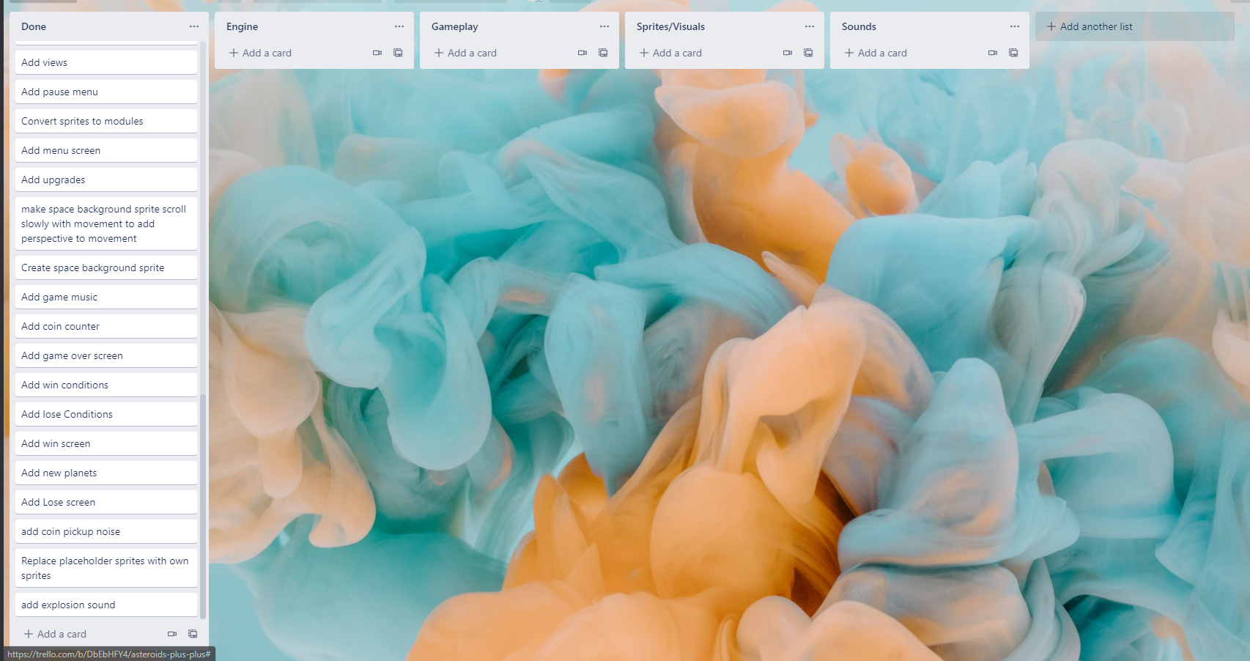
KANBAN Board at end of the sprint

Slide 8
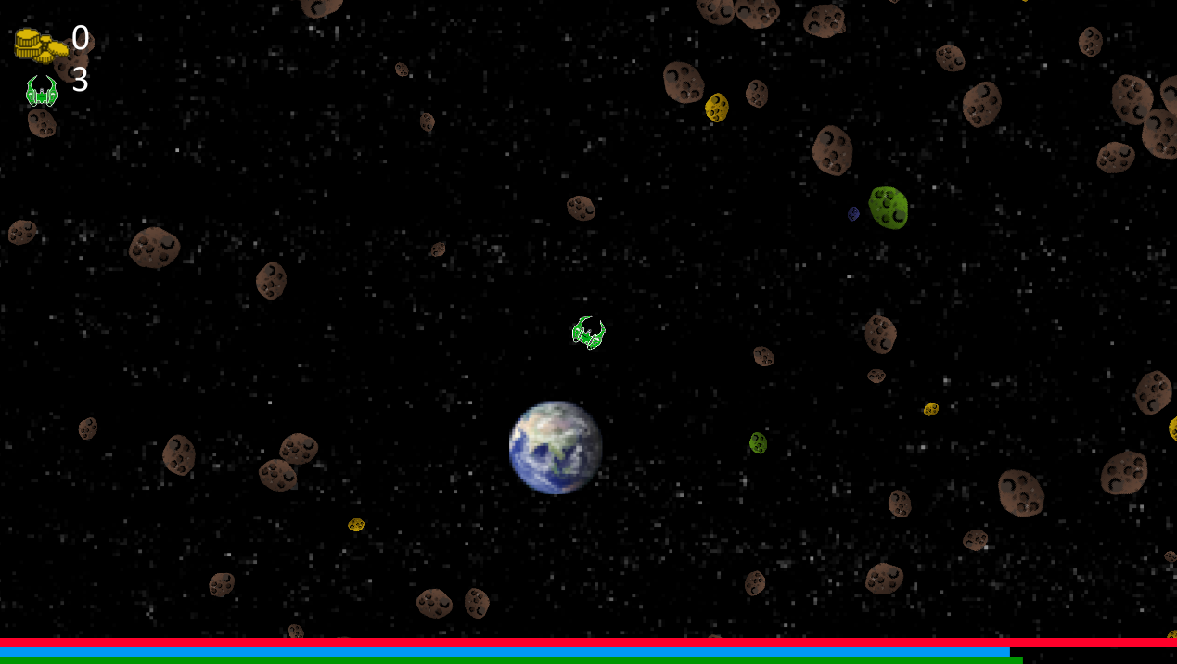
Screenshot of the game at the end of the sprint

Slide 9
Video of the game at the end of the sprint
https://youtu.be/IiWFvEfLYdE

Slide 10
Notes for next time, future improvements
The game is definitelly playable right now but in future updates more content could be added. I think a good first addition would be a timed mode where people could try and complete the game as fast as possible, additionally more planets with different sets of updates could easily be added with the way I have created my planet classes.

